Slide 1


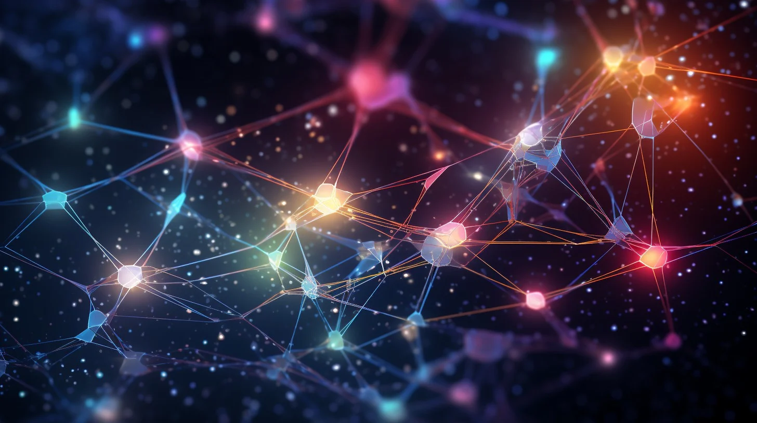

CO542
Neural Networks and Fuzzy Systems
NEURON
GLOW
Presented to you by:
FUZZBUSTERS
Notes:
"Imagine you’re trying to teach a toddler the difference between a cat and a dog. At first, they guess randomly, but every time you correct them, they get better at it. Eventually, they can tell them apart effortlessly!"
"Now, what if I told you that computers learn in the exact same way? They start with no knowledge, make mistakes, and improve over time."
"But here’s the problem – all of this learning happens inside a black box! It’s just numbers changing inside a computer, and for many, that makes AI feel like magic."
What if we could see through this box? What if we could bring this process to life? What if we could actually SEE a computer learning in real-time? That’s exactly what we’ve worked on"
Good afternoon, Ladies and Gentlemen, we are FuzzBusters, and this is our mini project presentation, Neuron Glow

Slide 2








OUR TEAM
FuzzBusters
Ravindu
Suraweeraarachchi
Pinindu
Thiwanka
Layani
Senevirathne
Ruwindya
Jayasekara
Janith
Wanasinghe
E/19/393
E/19/407
E/19/365
E/19/159
E/20/420
2
Notes:
This is FuzzBusters Team
Ravindu
Pinidu
Layani
Ruwindya
Janith

Slide 3
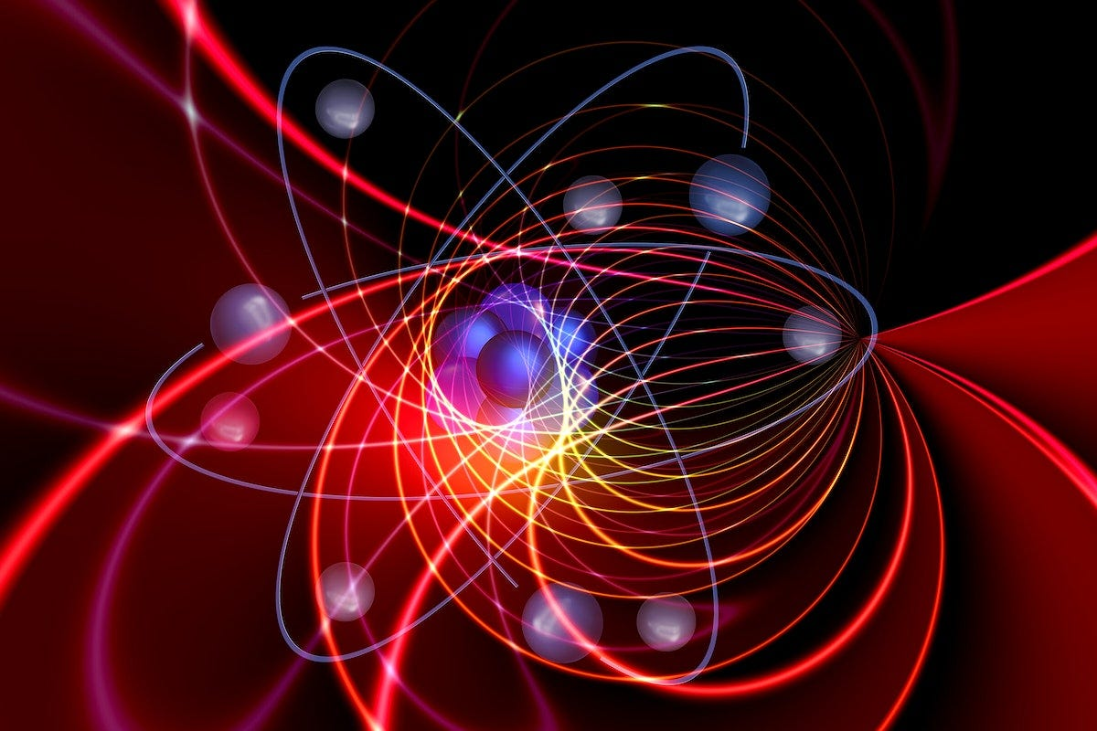
OVERVIEW
Our Key Talking Points
Introduction
Problem Definition
Our Solution
How it works
Challenges
Future Improvements
Individual Contributions
Conclusion
3
Notes:
This presentation will have
1) Introdcution to our project
2) How we defined the problem
3) Solution we worked on
4) The way it works
5) Challenges we faced
6) Future Improvements we plan
7) How each team member contributed to the work
8) Finally we will conclude the presentation

Slide 4


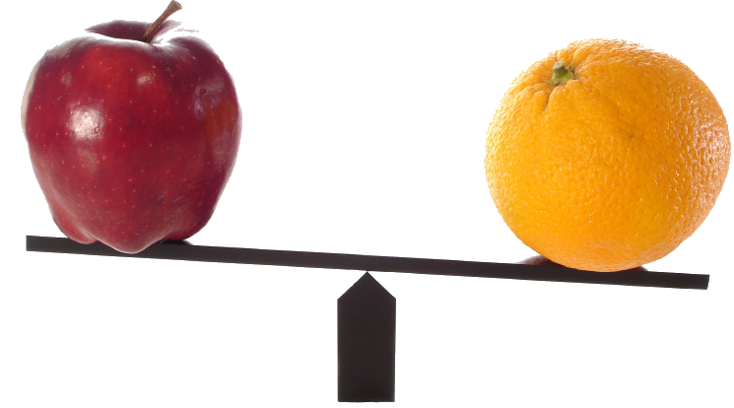

INTRODUCTION
How do we teach a toddler to recognize apples and oranges?
4
Notes:
Let's see for a moment how a toddler identifies apples apart from oranges.
At first, they guess randomly, but over time, they learn by adjusting their thinking based on feedback.

Slide 5

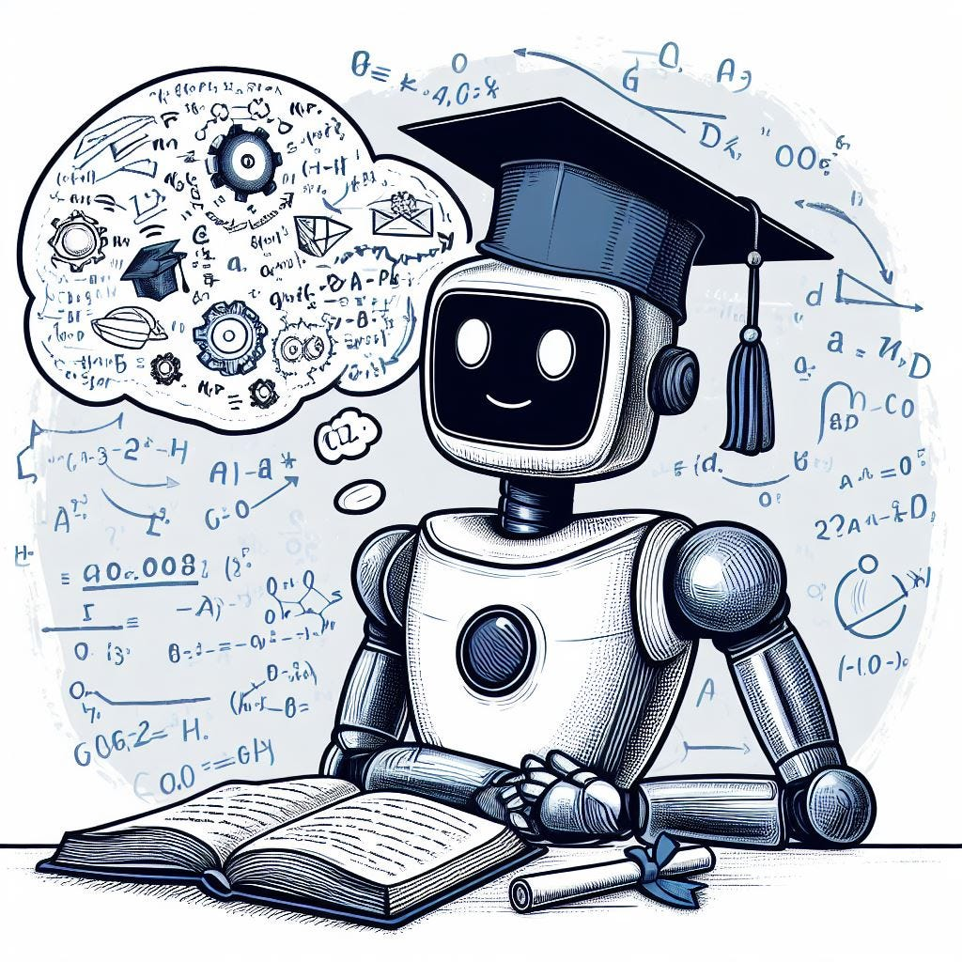
INTRODUCTION CONTD.
Computers learn the same way when it comes to ML!
“Computers start with no knowledge, make mistakes, and improve over time”
WE AIM TO HELP PEOPLE UNDERSTAND
HOW A MACHINE LEARNS
5
Notes:
Computers too act the same way, when it comes to ML.
They start with no knowledge, make mistakes, and improve over time.

Slide 6
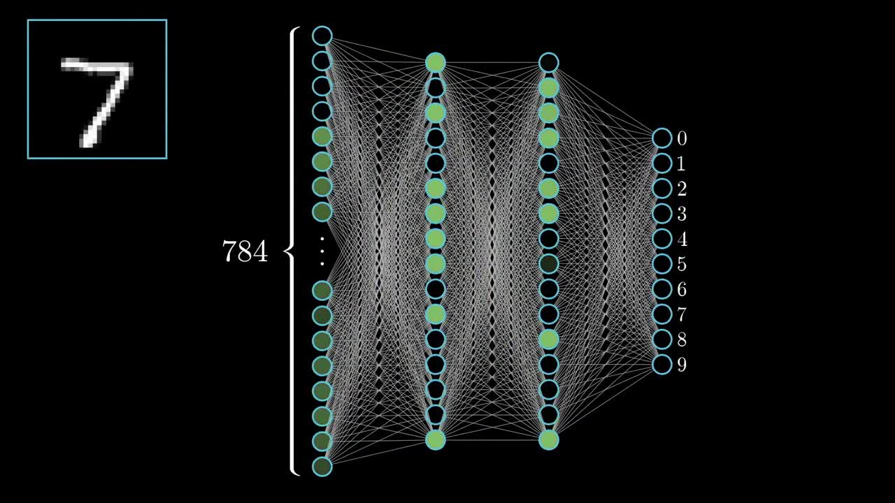
PROBLEM DEFINITION
How do machines learn?
A computer improves at a task by learning from data
One of the core techniques: Neural Network
January
What is a Neural Network?
Mimics how the human brain works
Layers of Artificial Neurons
Adjusts “weights” over time to make better decisions
6
Source : https://youtu.be/aircAruvnKk?feature=shared (3Blue1Brown)
Notes:
How Do Machines Learn?
The basic idea of Machine Learning (ML) is that a computer improves at a task by learning from data.
One of the core techniques in ML is the Neural Network, which mimics how the human brain processes information.
Neural Networks adjust their internal parameters (weights) over time to make better decisions—just like a child learning to recognize objects.
What is a Neural Network?
A Neural Network consists of layers of artificial neurons that transform input data to make predictions or classifications.
It learns by adjusting connections between neurons, strengthening useful ones and weakening others.

Slide 7
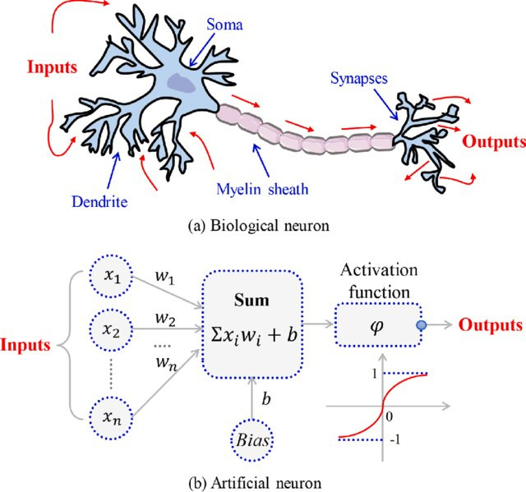
PROBLEM DEFINITION
How Neural Networks Mimic the Brain
7
Notes:
Neural networks are inspired by biological neurons in the human brain. Just like our brain processes information through interconnected neurons, artificial neural networks (ANNs) process data using artificial neurons (nodes).
Structure
Dendrites, Axon, Synapses Input, Weights, Activation Function
Communication
Electrical & Chemical Signals
Mathematical Computation
Learning Process Strengthening of synapses Weight Adjustment using Algorithms
Decision Making
Signal threshold activation Activation function (e.g., Sigmoid, ReLU)

Slide 8
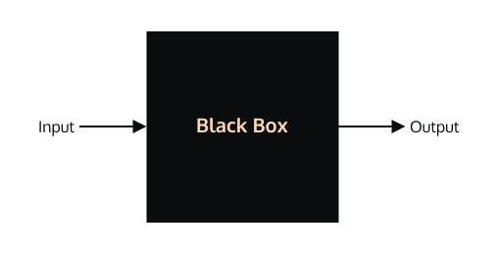
PROBLEM DEFINITION
Learning Neural Networks is TRICKY!
January
INPUT
OUTPUT
8
Notes:
Learning how AI works can feel like trying to understand how a magician performs tricks—it’s hidden inside a computer!
It works and we just work without having any sort of understanding whatsoever
We want to bring AI learning into the real world, making it visible and interactive using LEDs and switches.
Bringing AI Learning in to Real World
Visible
Interactive

Slide 9
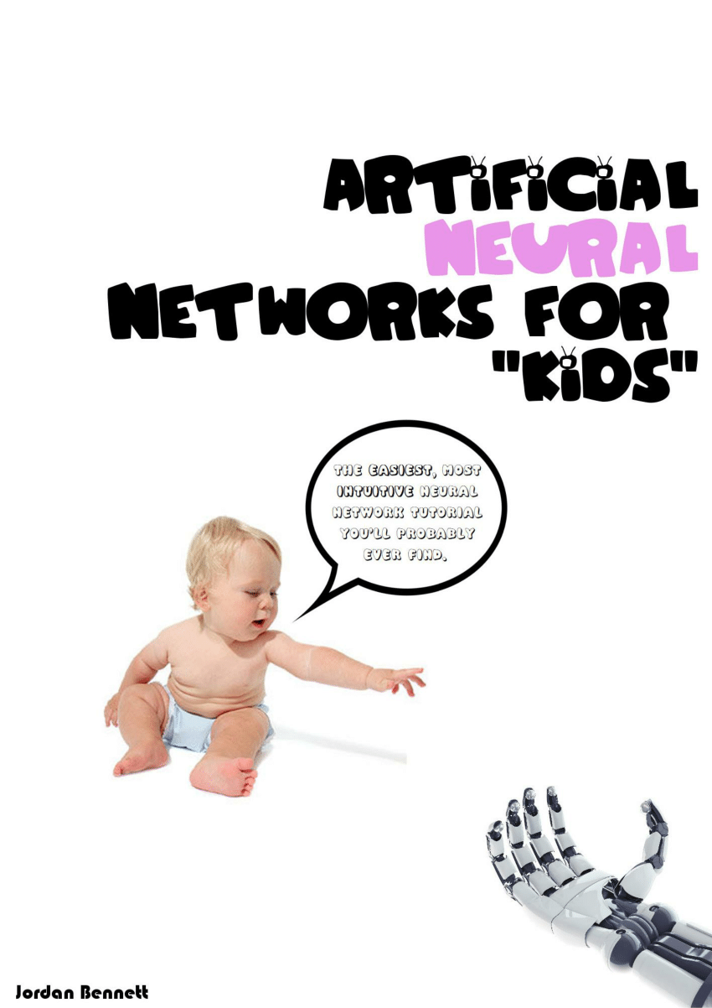
OUR SOLUTION - A HANDS-ON LEARNING TOOL
Hardware powered Single-Layer Perceptron
A simple AI model that learns and makes decisions.
Perceptron Living in ARDUINO
A way to visualize the Learning Process
9
Notes:
We are building a hardware perceptron—a simple AI model that learns and makes decisions.
Instead of running inside a computer, our perceptron lives inside an Arduino and shows its learning process using lights!

Slide 10
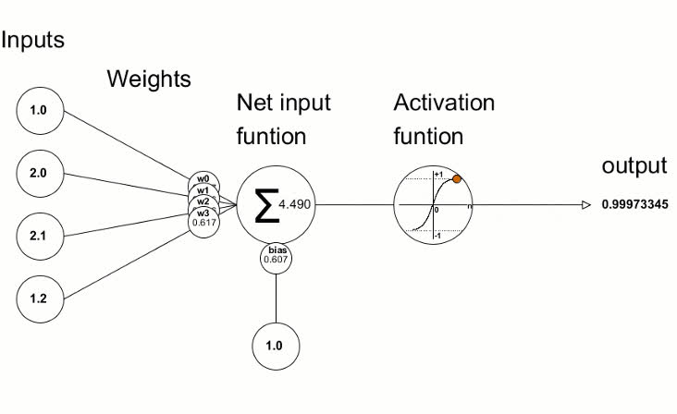
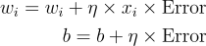
Our Solution - A Hands-On Learning Tool
10
Notes:
This is how a perceptron learns—by adjusting "thought patterns" (weights) every time it makes a mistake.
Our project builds a physical learning machine to show this process in action.

Slide 11

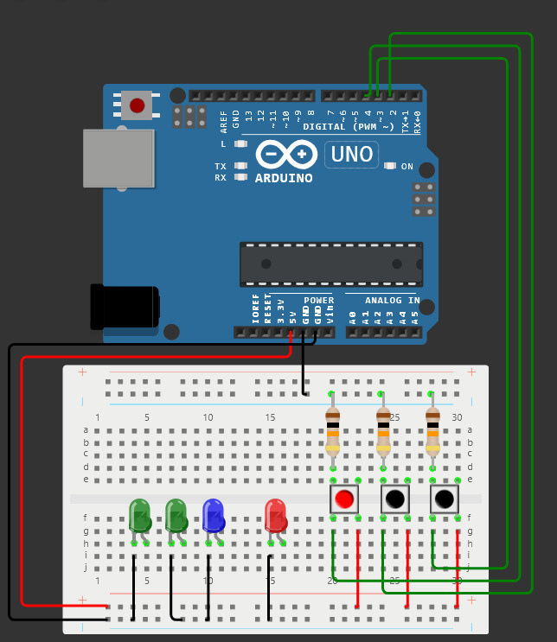
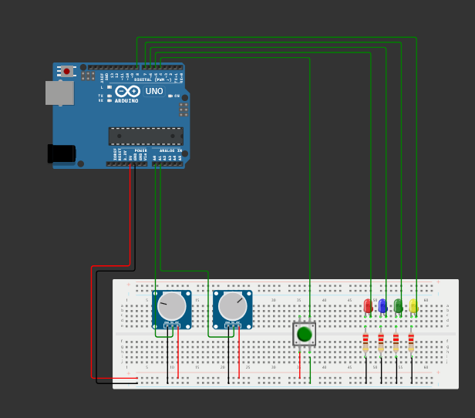
WHAT WE DID - IN A NUTSHELL
FUZZY-INSPIRED TRAINING: LEARNING OUTPUT BASED ON POTENTIOMETER RANGES
TRAINING “AND” GATE USING PERCEPTRON
11

Slide 12
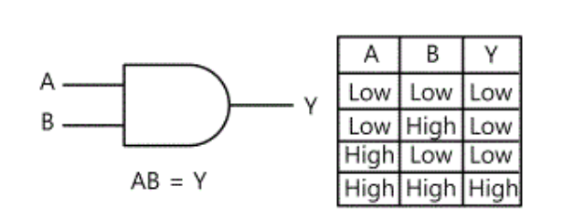
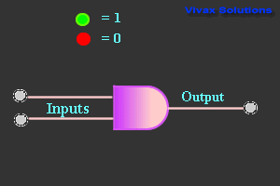
TRAINING “AND” GATE USING PERCEPTRON
AND GATE
12
Notes:
Inputs: Like a student observing apples and oranges, our perceptron gets inputs through potentiometers and a switch (like "eyes" for our AI).
Learning Process: It guesses, checks if it’s right, and then adjusts itself automatically—just like a student correcting their mistakes.
Outputs: Lights change to show how confident it is about its decision.

Slide 13
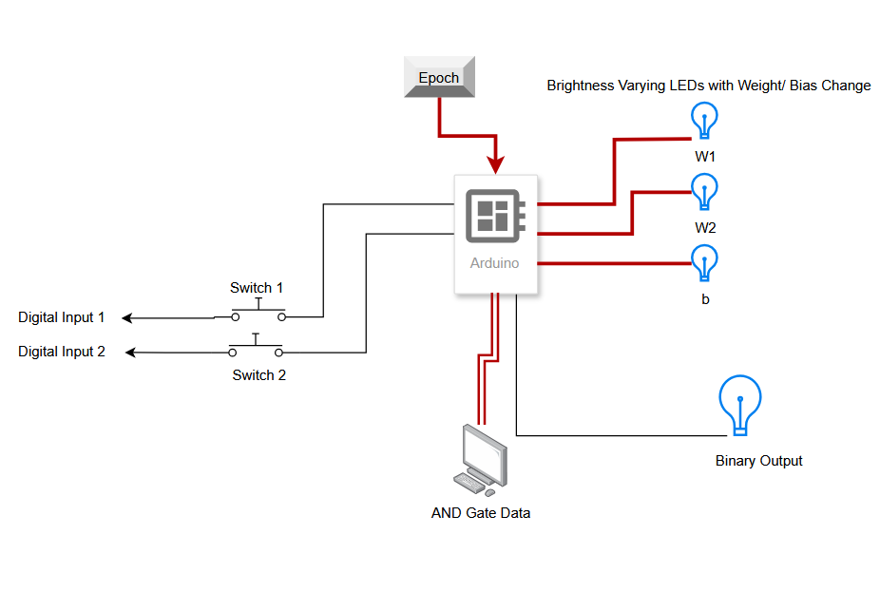
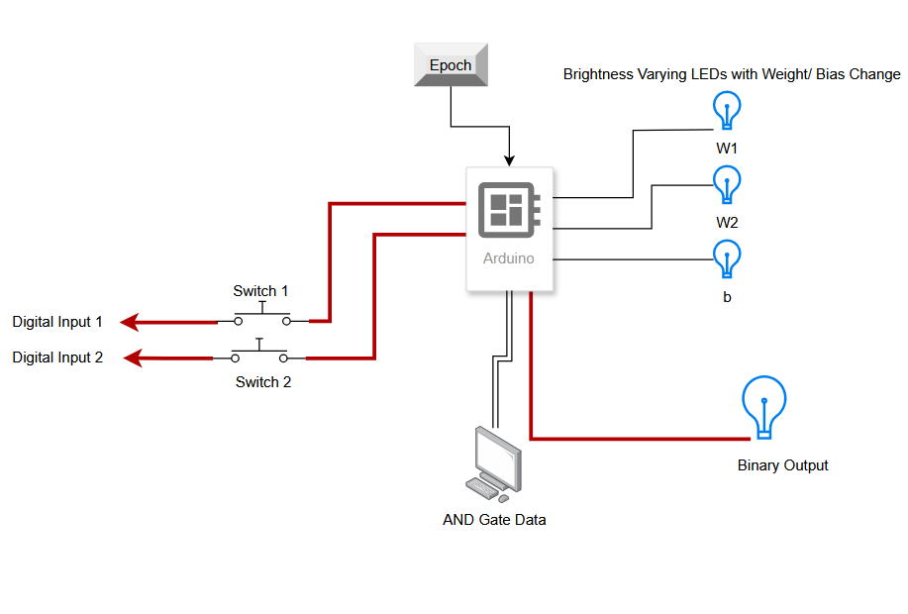
TRAINING “AND” GATE USING PERCEPTRON
Training State
Predicting State
13
Notes:
Key Features:
✅ Uses randomly generated dataset with balanced positive and negative samples.
✅ Implements a weight update mechanism that follows learning rate-based adjustments.
✅ Maps weight changes to LED brightness, helping visualize the learning process.
✅ Button-controlled training epochs, allowing users to see the perceptron improve over time.
Soft Decision Boundaries:
Gradual Learning Instead of Fixed Logic:
Continuous Input Range Instead of Binary Inputs:

Slide 14
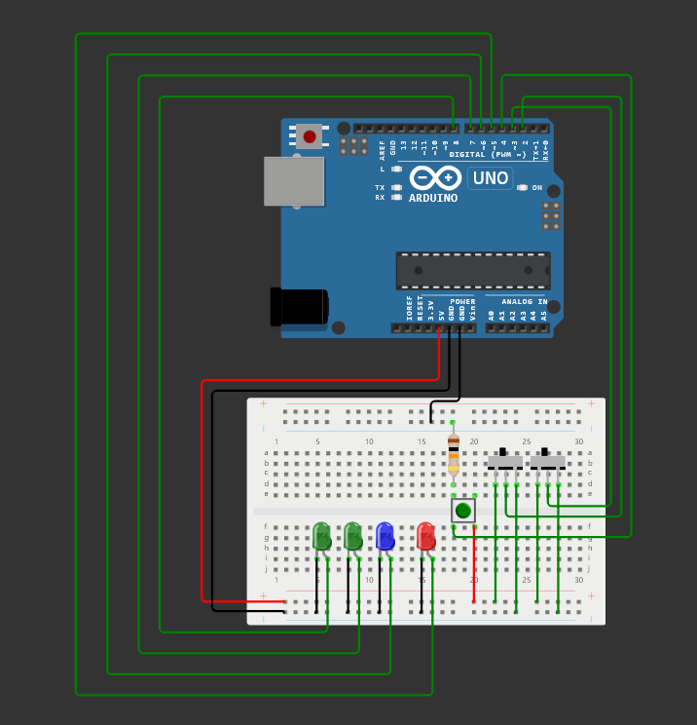
TRAINING “AND” GATE USING PERCEPTRON
Button-Controlled Training Epochs
Maps weights and bias to LED Brightness
Initial weights/bias can be assigned
Adjusts weights until it correctly mimics the AND gate behaviour
14
Notes:
Key Features:
✅ Uses randomly generated dataset with balanced positive and negative samples.
✅ Implements a weight update mechanism that follows learning rate-based adjustments.
✅ Maps weight changes to LED brightness, helping visualize the learning process.
✅ Button-controlled training epochs, allowing users to see the perceptron improve over time.
Soft Decision Boundaries:
Gradual Learning Instead of Fixed Logic:
Continuous Input Range Instead of Binary Inputs:

Slide 15
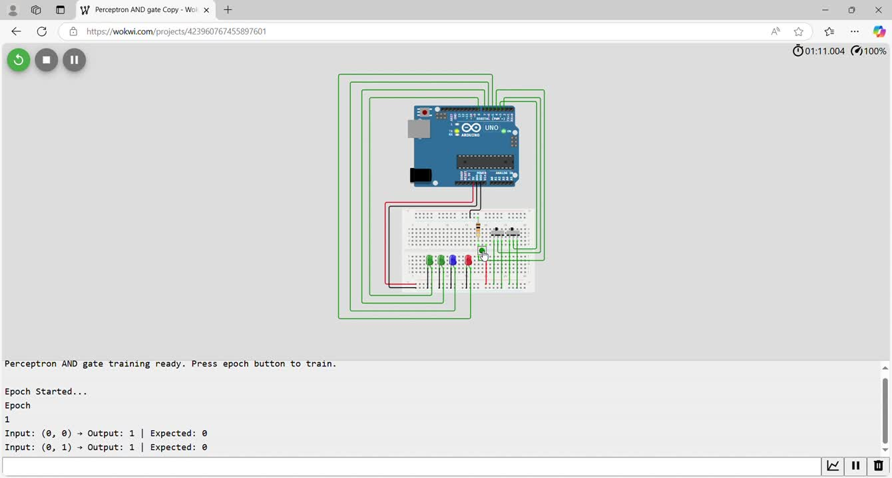
TRAINING “AND” GATE USING PERCEPTRON
15
Notes:
Inputs: Like a student observing apples and oranges, our perceptron gets inputs through potentiometers and a switch (like "eyes" for our AI).
Learning Process: It guesses, checks if it’s right, and then adjusts itself automatically—just like a student correcting their mistakes.
Outputs: Lights change to show how confident it is about its decision.

Slide 16
FUZZY-INSPIRED TRAINING:
LEARNING OUTPUT BASED ON POTENTIOMETER RANGES
If the potentiometer values fall within a certain range
Eg: pot1 between 0.1-0.4 AND pot2 between 0.4-0.7,
the output is trained to be 1;
otherwise, it's trained to be 0.
Adjusts weights using Error Correction
LEDs visualize changes in Weights and Bias
WHY FUZZY-INSPIRED?
Similar to Fuzzy Membership Functions
Continuous Input Range
Inputs mimic Fuzzy; output does not.
16
Notes:
Key Features:
✅ Uses randomly generated dataset with balanced positive and negative samples.
✅ Implements a weight update mechanism that follows learning rate-based adjustments.
✅ Maps weight changes to LED brightness, helping visualize the learning process.
✅ Button-controlled training epochs, allowing users to see the perceptron improve over time.
Soft Decision Boundaries:
Gradual Learning Instead of Fixed Logic:
Continuous Input Range Instead of Binary Inputs:

Slide 17
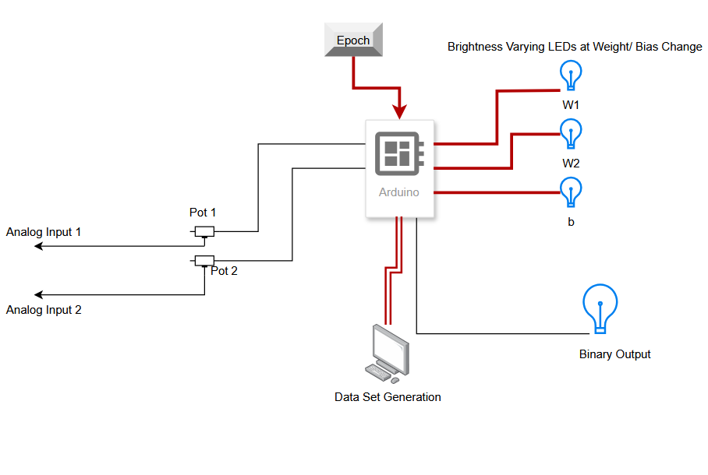
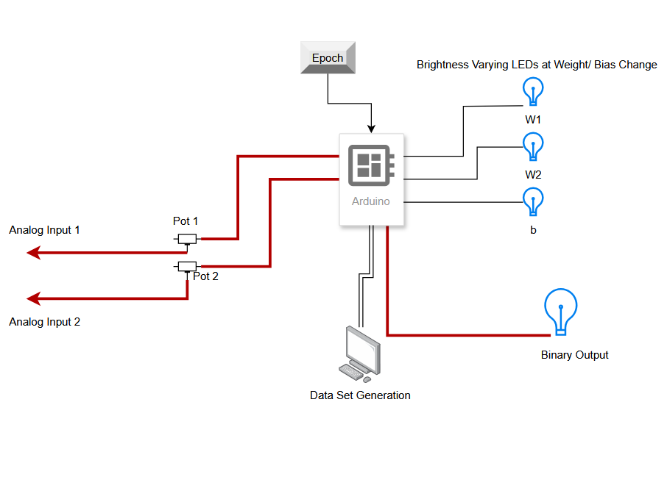
FUZZY-INSPIRED TRAINING:
LEARNING OUTPUT BASED ON POTENTIOMETER RANGES
Training State
Predicting State
17
Notes:
Key Features:
✅ Uses randomly generated dataset with balanced positive and negative samples.
✅ Implements a weight update mechanism that follows learning rate-based adjustments.
✅ Maps weight changes to LED brightness, helping visualize the learning process.
✅ Button-controlled training epochs, allowing users to see the perceptron improve over time.
Soft Decision Boundaries:
Gradual Learning Instead of Fixed Logic:
Continuous Input Range Instead of Binary Inputs:

Slide 18
FUZZY-INSPIRED TRAINING:
LEARNING OUTPUT BASED ON POTENTIOMETER RANGES
Button-Controlled Training Epochs
Learning Rate-based Weight / Bias Adjustments
Maps weight changes to LED Brightness
Randomly Generated Dataset for Learning
18
Notes:
Key Features:
✅ Uses randomly generated dataset with balanced positive and negative samples.
✅ Implements a weight update mechanism that follows learning rate-based adjustments.
✅ Maps weight changes to LED brightness, helping visualize the learning process.
✅ Button-controlled training epochs, allowing users to see the perceptron improve over time.
Soft Decision Boundaries:
Gradual Learning Instead of Fixed Logic:
Continuous Input Range Instead of Binary Inputs:

Slide 19
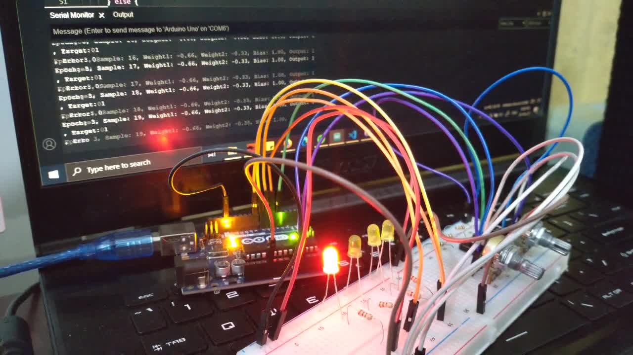
FUZZY-INSPIRED TRAINING:
LEARNING OUTPUT BASED ON POTENTIOMETER RANGES
19
Notes:
Key Features:
✅ Uses randomly generated dataset with balanced positive and negative samples.
✅ Implements a weight update mechanism that follows learning rate-based adjustments.
✅ Maps weight changes to LED brightness, helping visualize the learning process.
✅ Button-controlled training epochs, allowing users to see the perceptron improve over time.
Soft Decision Boundaries:
Gradual Learning Instead of Fixed Logic:
Continuous Input Range Instead of Binary Inputs:

Slide 20
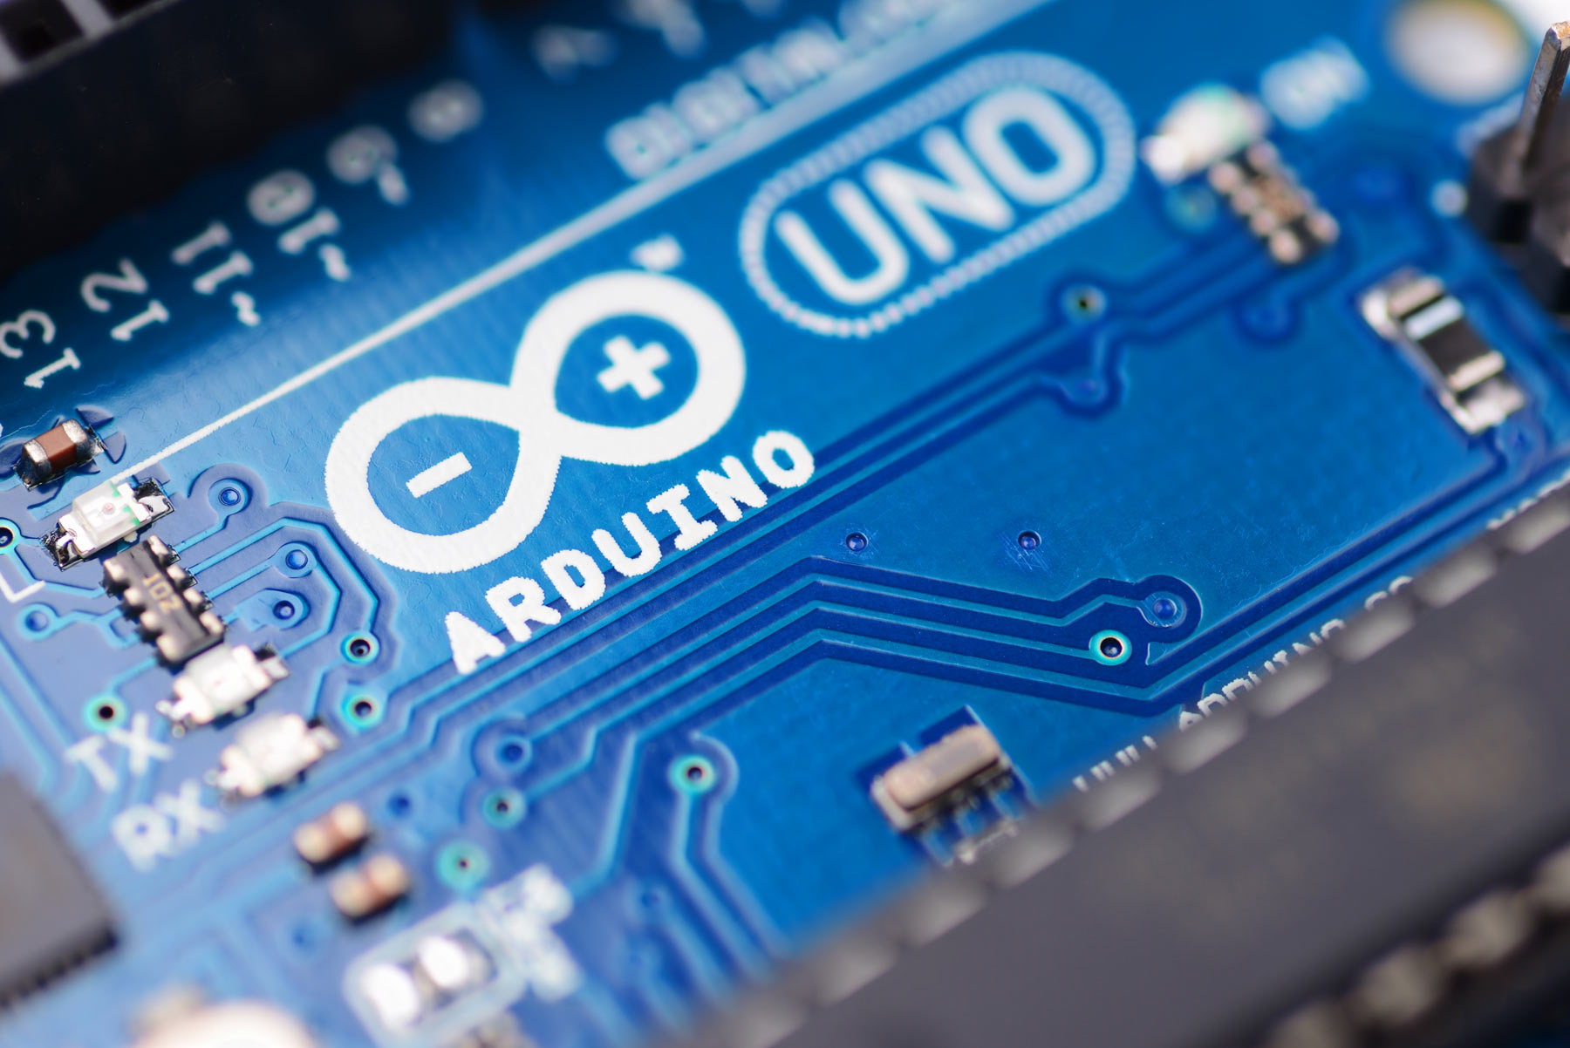
CHALLENGES
Arduino UNO : Hardware Limitations
Negative Weight Representation
Memory Limitations
ARDUINO Usage as a State Machine
Difficulties in mapping the brightness of LEDs to weights and bias
Currently limited only for Binary Classification
Integrating MLOps
20
Notes:
- Hardware Limitation : Ports,
- It is not possible to depict negative and positive weights in the same LED.
- Memory Limitation in ARDUINO UNO
Mapping is a challange as the weights and bias does not have a limited range

Slide 21

FUTURE IMPROVEMENTS
Using FPGA : To model perceptron with State Machine Approach
Using LED Bar or RGB to represent negative weights and biases
Using an LCD Display or 7 Segment Displays to show how the weights and biases are changing
Using an LCD screen to show internal calculations
Error Calculation
Respective weights / bias calculations
Use of MLOps in future iterations
21

Slide 22
INDIVIDUAL CONTRIBUTIONS
Janith Wanasinghe (E/20/420)
Leading the project idea forward
Scrum Board Maintenance
High Level Architecture Design
Ravindu Suraweeraarachchi (E/19/393)
Coding and Hardware Implementation of the two Perceptron Models
Simulation using Wokwi
Ruwindya Jayasekara (E/19/159)
Simulation of Perceptron Models
Layani Senevirathne (E/19/365)
Literature review on perceptron-based learning models & algorithms
Pinindu Thiwanka (E/19/407)
Documentation of Goal, Problem Definition, Scope, and Justification sections
22
Notes:
- Hardware Limitation : Ports,
- It is not possible to depict negative and positive weights in the same LED.
- Memory Limitation in ARDUINO UNO
Mapping is a challange as the weights and bias does not have a limited range

Slide 23

CONCLUSION
NeuronGlow demonstrates perceptron learning in an interactive, hardware-based setup
Bridges the gap between theoretical ML and real-world implementation
Potential for expansion into deeper neural networks and automation
Encourages hands-on learning for students and AI enthusiasts
23

Slide 24

REFERENCES
F. Rosenblatt, "The perceptron: A probabilistic model for information storage and organization in the brain," Psychological Review, vol. 65, no. 6, pp. 386–408, 1958.
M. Minsky and S. Papert, Perceptrons: An Introduction to Computational Geometry. Cambridge, MA: MIT Press, 1969.
M. Abadi et al., "TensorFlow: A system for large-scale machine learning," in Proc. 12th USENIX Symp. Oper. Syst. Des. Implement.*, 2016, pp. 265–283.
A. Paszke et al., "PyTorch: An imperative style, high-performance deep learning library," in Adv. Neural Inf. Process. Syst., vol. 32, 2019.
A. Suresh et al., "Hardware-based neural network simulation using Arduino," Int. J. Artif. Intell. Appl., vol. 11, no. 4, pp. 32–45, 2020.
W. Jiang et al., "An interactive perceptron learning tool with Arduino," Educ. Robot. J., vol. 9, no. 3, pp. 18–30, 2021.
A. Gupta and S. Verma, "Analog implementations of perceptron-based classification," J. Electron. Learn. Technol., vol. 6, no. 1, pp. 55–68, 2019.
S. Rothhaupt, W. Meyerle, and B. Kormann, "FPGA-based hardware acceleration of artificial neural network inference," in Proc. 6th AccML Workshop, 2024, pp. 1–6.
24

Slide 25
CO542
Neural Networks and Fuzzy Systems
THANK YOU!
Presented to you by:
FUZZBUSTERS
25

